Slide 1


Proactive Learning to Interview Selection
One step at a time

Slide 2
Agenda
What is proactive learning ?
How can it help you ?
Which resources to use ?
The power of time
Python and its wide applications
Interview selection
Demo –
Wi-Fi password getter
Web scrapping and PPT creation
Deep learning to play cart pole game

Slide 3
What is proactive learning ?
Keeping an open mind, suspending judgment, questioning assumptions, and seeking out information, technique, and perspective; and studying, practicing, and contemplating in order to build one's stored knowledge base, skill set, and wisdom.
Keeping an open mind
Suspending judgement
Questioning assumptions
Seeking information, technique and perspective

Slide 4
How can it help you ?
Understanding rather than memorizing
Learning by doing
Move away from spoon feeding
Learning to learn
Makes you more confident
Building your portfolio
Github - alif-arrizqy cassieeric
Linked In - Inspiring profiles - varun-chimurkar mohamedrekik gulshankumar-patle

Slide 5
Which resources to use ?
YouTube - Networking-PowerCertAnimatedVideos TechVideos-ParagDhawan
LinkedIn - Abhishek-thakur
Github - Dan-bader
Hackerrank / Hackerearth – java data-structures
Kaggle (Data science and ML) - courses
Instagram – coders.eduyear python.advance.projects pycoders java.world javascript.js
Medium articles - machine-learning-is-fun (series of posts)

Slide 6

The power of time

Slide 7
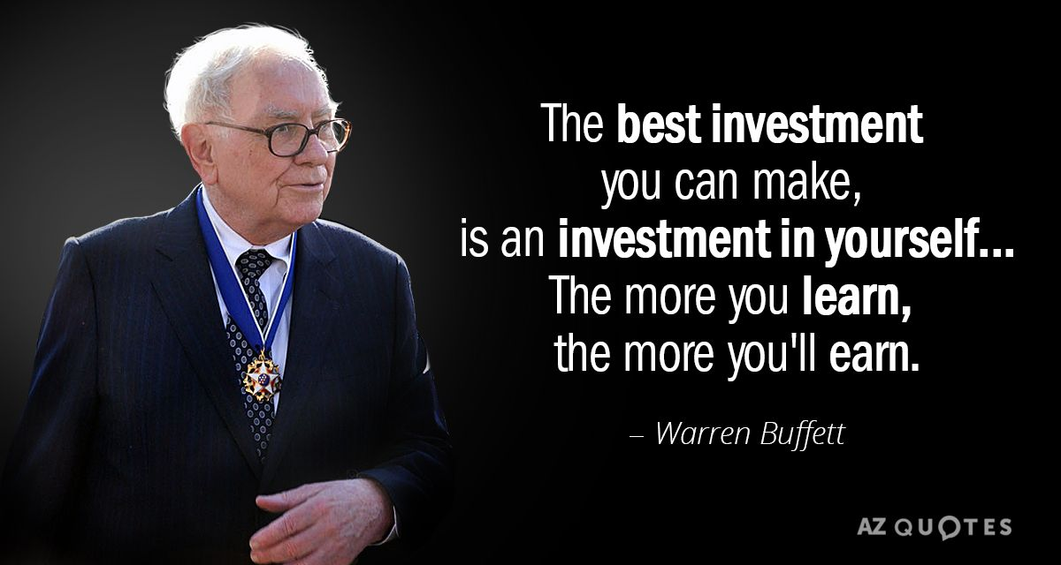

Slide 8
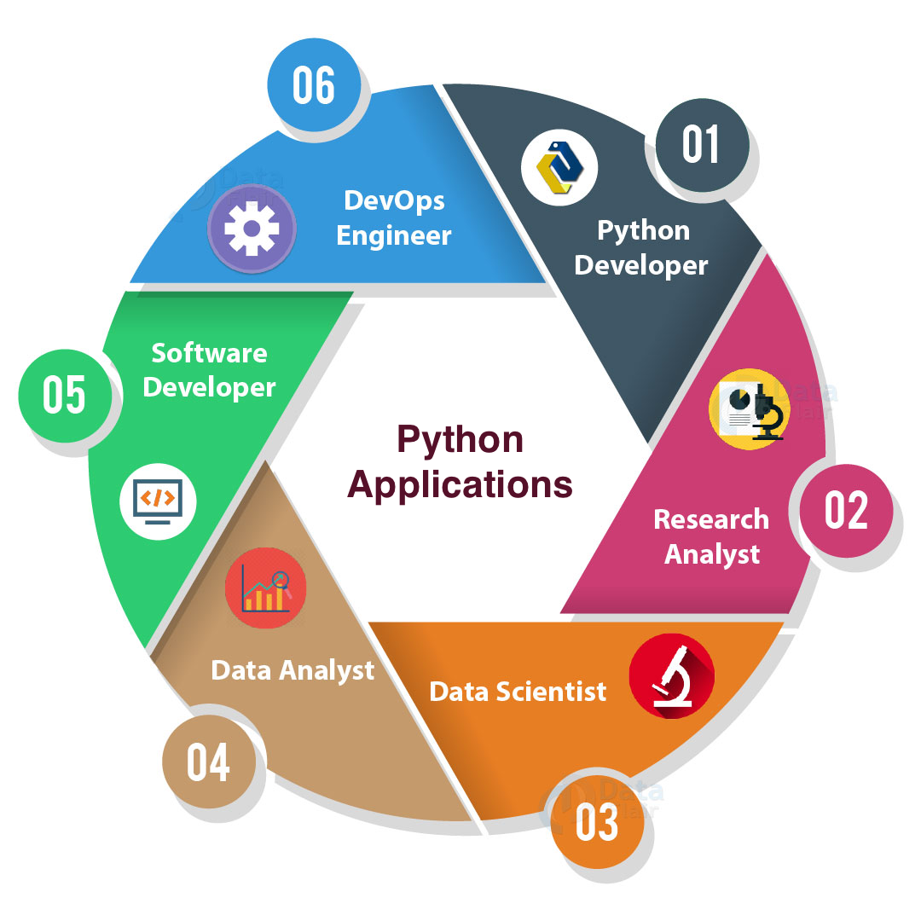
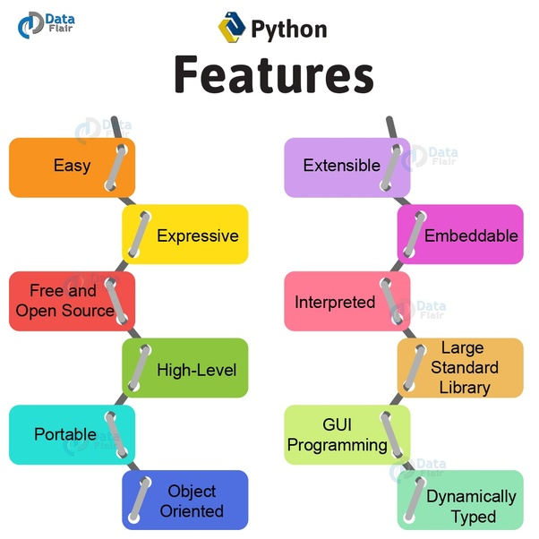
Python and its wide applications

Slide 9
Interview selection
Focus on logic rather than syntax
Easy to explain
Smaller code even 1 liners as compared to other languages
Free resources to learn - data-structures-and-algorithms-in-python
Faster to implement and test using console

Slide 10
Demo
Wi-Fi password getter
Web scrapping and PPT creation
Deep learning to play cart pole game

Slide 11
THANK YOU
Questions ?

Slide 12
Contact
Rohit Shende
Linked In | https://www.linkedin.com/in/rohit-shende-3159a292/
Email | rohitshende16@gmail.com

